Slide 1

DriverPass System Analysis
Zachariah Spencer

Slide 2

System Requirements
The system must validate user credentials during login.
The system must book reservations made by the user.
The system must allow modifications to users and the removal of users without altering the code.
The system must be fast enough to ensure seamless user access.
Notes:
There are many system requirements in my design for the new DriverPass system, so I have selected only four to share with you all today.
The first is that the system must validate user credentials during login. This means the system will have a fully featured login page which keeps track of each individual person’s permissions and only makes the parts of the system that are relevant to that unique person accessible. This is a major component to ensure both the user’s and the system’s security.
The second is that the system must book reservations made by the user. The system needs to allow reservations to be made without having to contact a DriverPass staff member directly. The system will also manage which times are booked on instructor’s calendars and only allow appointments to be booked when there are no conflicts. This will save the DriverPass staff countless hours of labor.
The third is that the system must allow modifications to users and the removal of users without altering the code. This means that there must be a means for administrative DriverPass staff to manage user accounts utilizing the DriverPass online interface. Without this implementation, the staff would have to get a programmer anytime a user was finished using the site or a staff member resigned. This requirement ensures that the system can be upkept by the DriverPass time without needing a specialist’s assistance.
The fourth requirement is that the system must be fast enough to ensure seamless user access. This one is straightforward but also crucial to the rest of the system’s success. When a user accesses DriverPass online, it should always load quickly and be responsive to the user’s control.

Slide 3
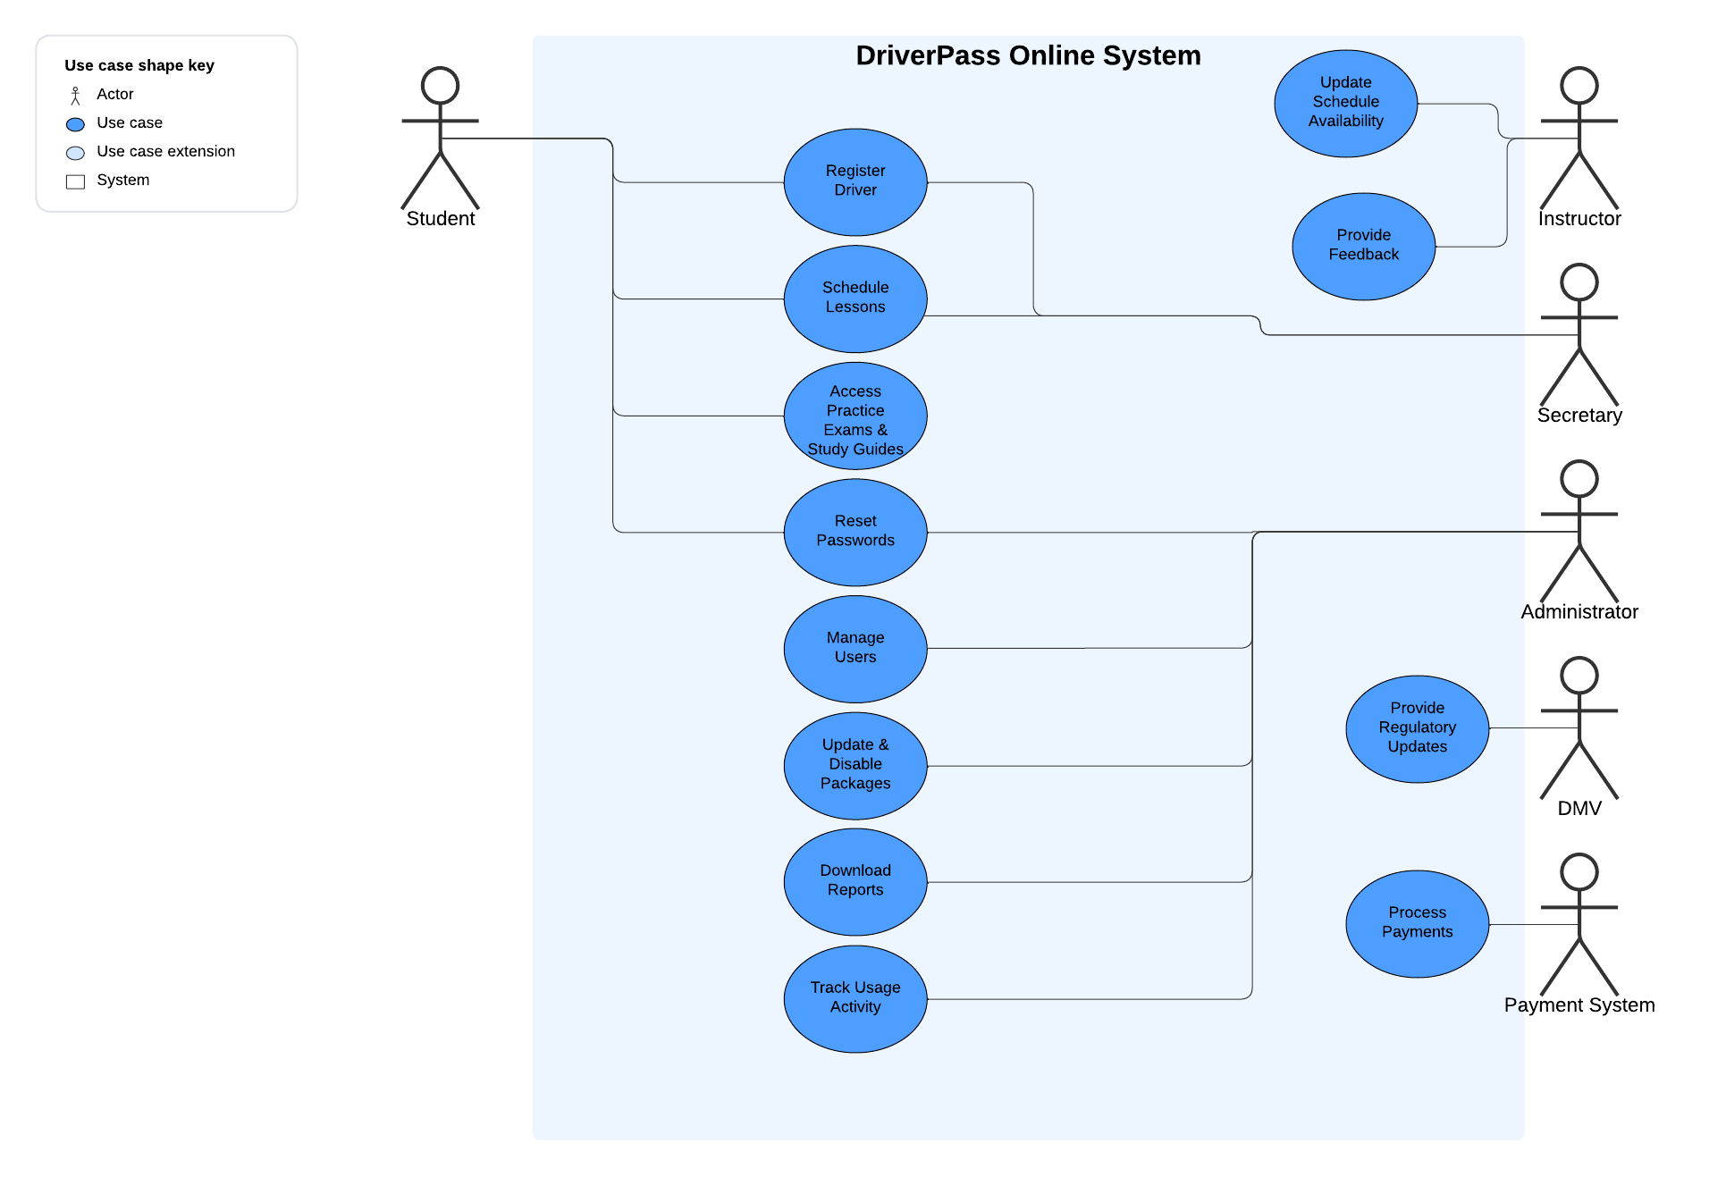
Use Case Diagram
[Insert your use case diagram here.]
Notes:
The DriverPass online system provides student driver’s a self-managed environment to learn driving concepts and book appointments with driving instructors online. It also provides tools for instructors to help them support the student driver’s experience, as well as providing a way for DriverPass’s administrative staff team to manage, track, and customize important aspects of the system without the need for a technical specialist. Finally, the DriverPass online system connects to the DMV to ensure the system’s resources are compliant with the latest regulations, as well as connecting with an easy-to-use external payment system so new customers can pay to use the system with their debit or credit card. The visual aid you see on screen is not a comprehensive look at the system’s design but it does provide us with an overview of several of the ways that different types of user’s may interact with the system, which is aiding our team in making sure the system meets all of your company’s and customer’s needs. As you can see, student’s will register themselves as a driver, schedule lessons with instructors, access online educational resources, and occasionally need to reset their password. A secretary can also find the student in the system and book a lesson with an instructor on their behalf. Instructors will need to keep an up to date scheduling availability that the system can track so it ensures that driver’s are only able to schedule lessons at appropriate times within business hours and when the instructor is working. The system will also provide instructors with a built-in means to communicate feedback to the student regularly. Any administrative members of DriverPass’s team may need to reset passwords on a customers behalf. They also may need to manage, modify, or delete user accounts such as when a driver graduates or an instructor resigns. They need to be able to adjust the types and pricing of the different packages sold by DriverPass in the event that DriverPass’s pricing model changes over time. Finally they may want to track how the DriverPass online system is being used and download reports of sales, completion rates, and more. Designing the system with your team and customer base top of mind will ensure that the finished system meets the needs of your company.

Slide 4
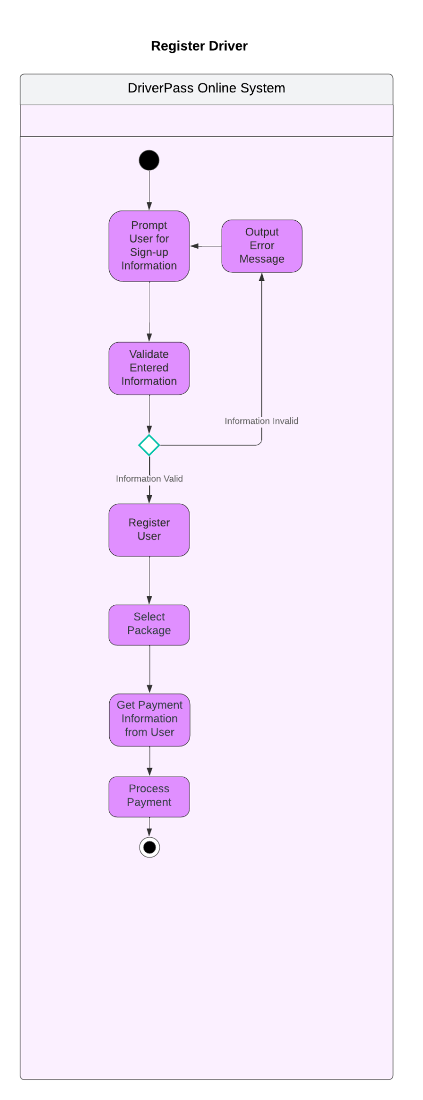
Activity Diagram
Notes:
One of the most common uses of the site will be to register new student drivers to the system. This system is self guided and aims to provide a clean first impression to new customers of the convenience that DriverPass online provides them. The system will provide a digital form for the user to fill out with their personal information and their desired login ID and password. It will then verify that all of this information makes sense and meets the regulatory requirements set by the DMV. If this information does not meet the requirements the system is designed to check for, it will politely inform the user of the discrepancy and ask them to try again. Once the user has entered the appropriate information, the system will register that user and prompt them to select a pricing package for DriverPass’s services. The user can then select any of the available options and the system will prompt them to enter their debit or credit card information. Once the user has entered this information, the system will process their payment and grant them access to the system’s features.

Slide 5
Security
Users will need a username and password to log in, along with multi-factor authentication.
The cloud will handle the data exchange between the client and server.
The system should disable an account after four incorrect login attempts to prevent brute force attacks.
If a user forgets their password, they will be prompted to enter the email associated with their account, and a password reset link will be sent to that address.
Notes:
This system will keep track of sensitive data such as user’s personal information, which means security needs to be a priority in the system’s design. We plan to incorporate several robust features that will keep both the DriverPass team and it’s customers safe and secure.
Firstly anybody using the site will need a login ID and a password to login. They will also need to set up a separate way to confirm their identity such as an email address or a phone number the system can text them at. This will allow the system to keep any unwanted intruders from maliciously accessing an account even if they have wrongly acquired someone else’s login credentials.
Secondly any data being given from someone using the system to the system itself will be handled using a persistent separate entity, which will ensure that even if someone could access the system maliciously, they still could not access the system’s sensitive data while it is in transit from someone’s computer to the system or vice versa.
Thirdly, the system is designed to disable an account if somebody attempts to login to an account with an incorrect password more than three consecutive times. This can be unlocked by reaching out to DriverPass’s customer support team where they can verify the user’s identity and ensure their account is not being stolen.
Lastly as I mentioned earlier in the presentation, the system will have a means for a user to reset their own password which will also unlock their account. This requires them to enter the email associated with their account and then the link to reset their password is sent to that address if it is found to be associated to a current account in the system. This adds another layer of security to user accounts as someone attempting to gain access to an account that is not theirs will also have to have access to the actual account owner’s email as well.

Slide 6
System Limitations
The system will not have a way for non-technical staff to customize functionality intuitively.
The system will not allow users to download educational resources.
The system will not provide instructors with a way to track student’s learning analytics
Notes:
There are some limitations to our design for the system. A few of these are listed here. One limitation we foresee is that other than the packages made available and user account information, the system will not provide a way for the DriverPass team to customize its core functionality and core feature changes will require more work from technical specialists. The system will allow users to take practice exams online as well as view educational resources and images online, but it will not have the ability for users to download these resources into an offline format. Finally the system will not provide instructors with a means to track student’s learning progress. This means that some course tracking will need to be done manually by instructors in tandem use with the system in order to provide a smooth learning experience. Most of these limitations could be fixed in a future update of the system with some more time allocated from our development team. Overall we are excited with what we were able to accomplish within the timeline you requested and we feel the system we are preparing to deliver will meet all of DriverPass’s primary needs.

